Slide 1
Forecasting “As Is” Process Workshop
May 7, 2003
5965 Coopers Ave., Mississauga

Slide 2
Agenda
Project CASPER Overview (15 min)
Workshop Introduction (15 min)
  Objectives
  Team
  Approach
Refine the high level Plan “As Is” Process (1 hr)
Walk the Process & Record (3-4 hrs)
  Problem Areas
  Rules
  Improvement Ideas
  Measurements
Alan Pinington
Alan Pinington
  “
  “
  “
All
All
  “
  “
  “
  “

Slide 3
RETAIL CYCLE
Project CASPER Overview
Analyze
Measure, Monitor & Manage
Plan
Execute
Plan
Buy
Order
Follow-Up
Move
Store
Logistics
Sell
Track
Results
Supporting Services

Slide 4
Katz Value Chain… Process model to assist in understanding the business process
Plan
Buy
Move
Sell
Market Analysis
  Research
Price Management
  Promotion Planning
Advertising
Forecasting/Demand Planning
Category Management
  Planograms
  Assortment Planning
  Category Profitability
Item Management
Inventory Management
Private Label Development
Merchandise Planning
Vendor Terms
Vendor Relations
Sourcing
Contract Management
Supplier Performance
Purchasing execution
Inventory Management Execution
Product Allocation
Order Management
Store Replenishment
Forward Buying
Collaboration (EDI, XML)
Inbound Management
  Appointment Scheduling & Sequencing
  Traffic & Transportation
  Import compliance
Warehouse Management
  Receiving
  Capacity Planning
  Pick & Pack
  Whse Replenishment
  Inventory Management
  Forecast Planning
  Vendor Collaboration
  Shipping / Shipment Consolidation
Outbound Management
  Scheduling (ASN’s)
  Freight
Customer Relationship Management
  Customer Relations
  Customer Queries
  Customer Complaints
  Refunds
Point of Sale
  Store Sales
Store Receiving
  Invoice Settlement
Store Orders
  3rd Party Order Taking
  Vendor Managed Inventory
Vendor Returns
Home Health Care
  Equipment Rental
Telesales
REPORTING, MONITORING, COST ANALYSIS AND ANALYTICS
ENTERPRISE INFRASTRUCTURE - Strategic Planning, Legal, Government Affairs, etc.
FINANCE & ADMIN - Accounting, Audit, Treasury, Human Resources, etc.
TECHNOLOGY DEVELOPMENT - IT, Telecommunications, etc.
HUMAN RESOURCE MGMT - Recruiting, training, compensations, etc.

Slide 5
Workshop Objectives
Determine the status of each of the business processes / sub-processes within the project scope so that recommendations can be tailored accordingly.
Identify problem areas.
Identify improvement opportunities.
Identify areas where the current processes / sub-processes are performing well and are candidates to keep in the future design.
Identify whether the processes / sub-processes are critical to the business, industry standard or basic
Identify potential opportunities for process / sub-process harmonization across divisions.
Identify potential opportunities to move responsibility for processes / sub-processes, e.g., to / from customers, suppliers, etc.

Slide 6
Participants
Katz
  Sal Galle Category Manager
  Nelia DeSouza Category Manager
  Brian Millier Rexall
  Wade LeCur Rexall
  Shirley Foley Distribution Services
  Scott Wilton
IBM
  Alan Pinnington
  Angelo Cina

Slide 7
Approach

Slide 8
During the workshop we will use a set of ground rules to assist us in focusing our discussion.
Equal vote
Listen to each other
One conversation at a time
Participation vs.. sideline-sitting
Silence means consent
"Brainstorming" vs. "Debating" vs. "Criticizing"
There are no bad ideas!
Work towards a consensus
Full-time participation by everyone
If it isn't written down, it didn't happen
Have some fun !

Slide 9
High Level Front Shop Forecasting “As Is” Process
Sample
Consumer
Katz Stores
Review store past sales @ price point
Forecast future sales period
Subtract inventory available for period
Buy
DT Stores
Category
Management
Review aggregate past sales @ price point
Forecast future sales based on promo
Compare prebook to aggregate forecast
McKesson
POS
Systems

Slide 10
Problem Areas
Manual correlation between industry information from vendor to forecast
No ability to store industry knowledge across category manager
Forecast stored in Excel and are manually created for forces distribution
No forecasting modeling tools
No forecast for commitment or direct items
Forecast perceived by vendor to be commitment is not executed by store in total for distribution
Lack ability to net inventory from distribution forecast
Lack ability to create a specific store forecast
No one forecasting package (distribution compilation for one ad, separate memo’s additionally)
Lack visibility of prior promo criteria when making forecasts at store level
Assumptions are changed with no time for vendors to react
Only have time to hit the high movers (front page, back page, inside features)
Don’t see a ranking of promo
Overlapping planning within the order time frame

Slide 11
Rules

Slide 12
Improvement Ideas
One information package for one ad
Synchronizing infoplus information to an ad
Visual/Pictures in ad package
One integrated system for sales information
Update Microstrategy daily
Automated forecasting tool for regular sales and promo sales
Track against forecast
Daily inventory movement
Out of stock visibility at store level – measure forecast accuracy
Extend collaboration with vendors
To eliminate overlapping promos
  Longer promos
  Less items on promos
  Less product repeats on ads
  Improved communication to stores

Slide 13
Measurements

Slide 14
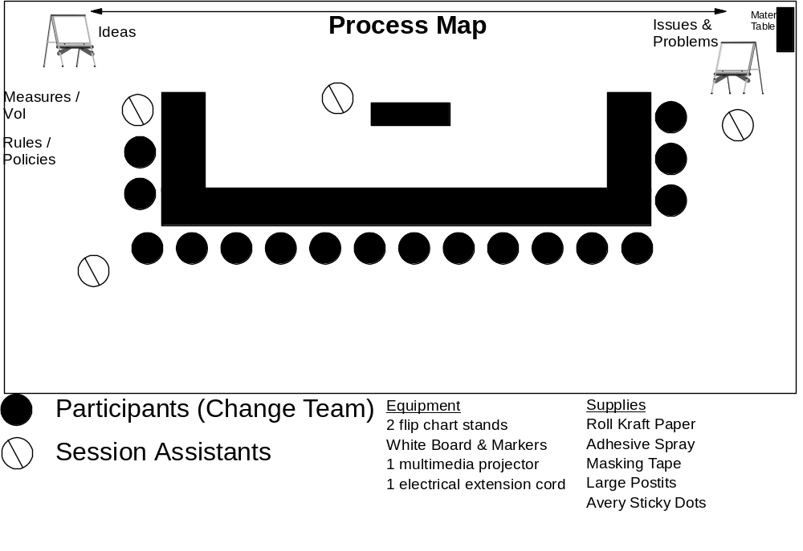
Workshop room with one long clear / clean wall, large enough to allow for catering to be in the room and easy movement

